Slide 1



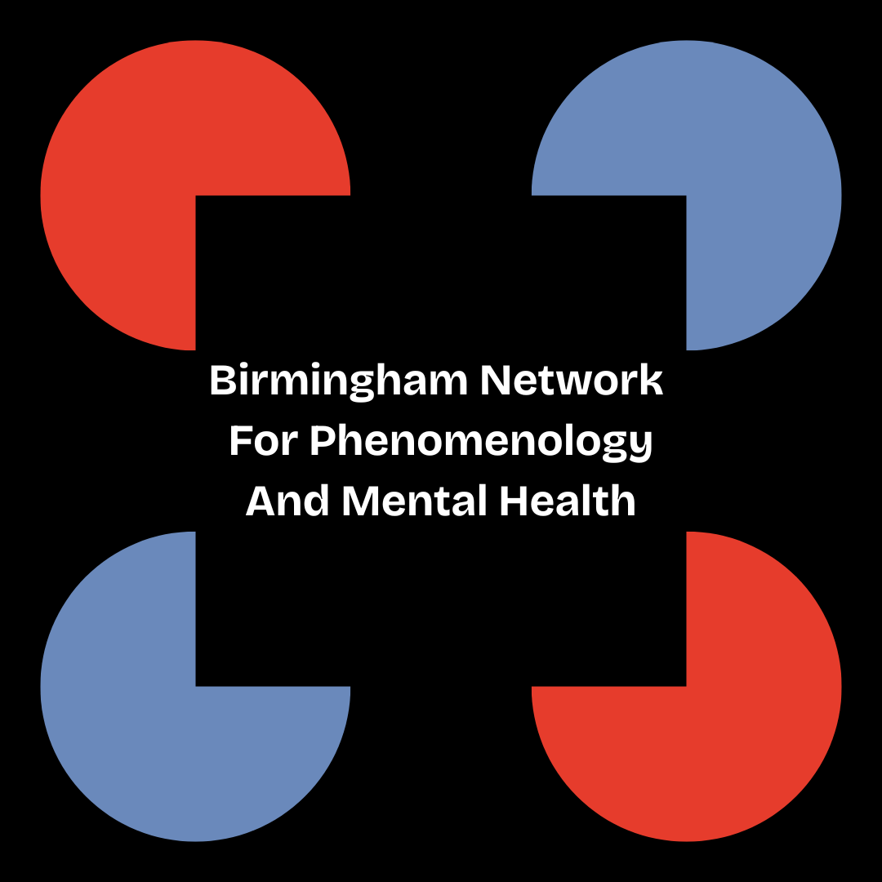

Intersectional invisibility and its impact on belongingness and being understood
Dr Jodie Louise Russell
Research Fellow
Epistemic Injustice in Healthcare project (EPIC)
Birmingham Network for Phenomenology and Mental Health
School of Psychology, University of Birmingham
j.l.russell@bham.ac.uk • @jelliedsours.bsky.social

Slide 2
Introduction
Project aim: to investigate the impact of epistemic injustice on young people with psychosis on their sense of belonging
Overview of talk:
  Epistemic Injustice, young people and psychosis
  The impact of intersectionality and epistemic injustice on health research

Slide 3

1. Young people and psychosis
Patients often feel that clinicians, and even their loved ones, don’t listen to their experiences or take their reports seriously
A lack of credibility afforded to patient testimony can often lead to harm
  For example: misdiagnosis, over pathologization or under-pathologization, a failing trust in healthcare professionals or the patient themselves, and inadequate or inappropriate treatment

Slide 4
1. Young people and psychosis
Discrediting patient experience based on prejudice is a form of epistemic injustice (Fricker 2007)
Two main types:
  Testimonial injustice: where an individual is harmed due to being treated as an inadequate knower in a given situation
  Hermeneutic injustice: where individuals are excluded from using particular concepts to understand their experiences or are unable to contribute concepts of their own

Slide 5
1. Young people and psychosis
Psychosis is a particularly pertinent example of where epistemic injustice may arise:
  E.g. due to its characterisation: the ICD-11’s description of “Schizophrenia or other primary psychotic disorders”, as “impaired reality testing”
  The psychosis population is disproportionately represented by individuals from Black, Asian and Minority Ethnic (BAME) backgrounds in England (Public Health England 2016) and internationally (Jongsma et al. 2019)
  Psychosis is a disorder that most frequently manifests in younger men, with the typical age of first episode of psychosis between late teens and early adulthood

Slide 6

2. Impact of intersectionality
Young people with psychosis are therefore likely to experience testimonial injustice as a result of prejudice against multiple features of their identities
What’s the impact of this multiple group membership?
Purdie-Vaughns and Eibach (2008) argue that belonging to multiple group identities can also render individuals invisible with respect to those identities

Slide 7
2. Impact of intersectionality
This is because membership multiple groups might mark you as an ‘atypical’ member with respect to one or more of these groups
  E.g. being a young man with psychosis might make you both an atypical young person (e.g. because of stereotypes of ‘youthfulness’ and ‘carefree’), an atypical mentally ill person (Schizophrenia is not very prevalent compared to other disorders)

Slide 8
2. Impact of intersectionality
Intersectional invisibility thus creates issues for mental health research:
  Potential participant might then unknowingly rule themselves out (because they can’t rule themselves in)
  They might also not be appropriately offered opportunities to participate (because they aren't 'atypical' cases or its 'too much work' to include them)

Slide 9
2. Impact of intersectionality
Being excluded from group projects in this way also prohibits from individuals taking part in projects that would address that invisibility
  E.g. projects around generating and sharing knowledge (like healthcare care research)
Young people with psychosis might then be excluded from accessing and contributing conceptual resources and may feel alienated and alone

Slide 10

3. Discussion
How do we conduct intersectional qualitative studies to start with?
How do we include intersectionally invisible participants?
What does intersectional invisibility mean for healthcare practice?

Slide 11
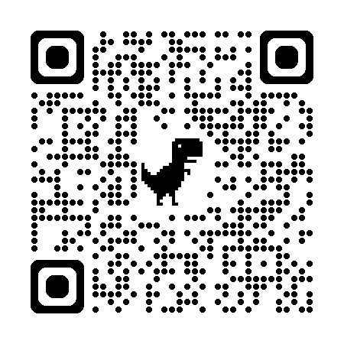
Thank you!
References:
Fricker, M., (2007), Epistemic Injustice: Power and the Ethics of Knowing, Oxford University Press.
Jongsma, HE., Turner, C., Kirkbride, JB., Jones, PB., (2019), “International incidence of psychotic disorders, 2002-17: a systematic review and meta-analysis”, Lancet Public Health, May, 4(5), e229-e244
Public Health England, (2016), “Psychosis data report”, [Online] Available: https://www.gov.uk/government/publications/psychosis-data-report [Accessed 29/10/2024]
Purdie-Vaughns, V. and Eibach, R.P., (2008), “Intersectional invisibility: The distinctive advantages and disadvantages of multiple subordinate-group identities”, Sex Roles, 59, pp.377-391.
EPIC website

