Slide 1
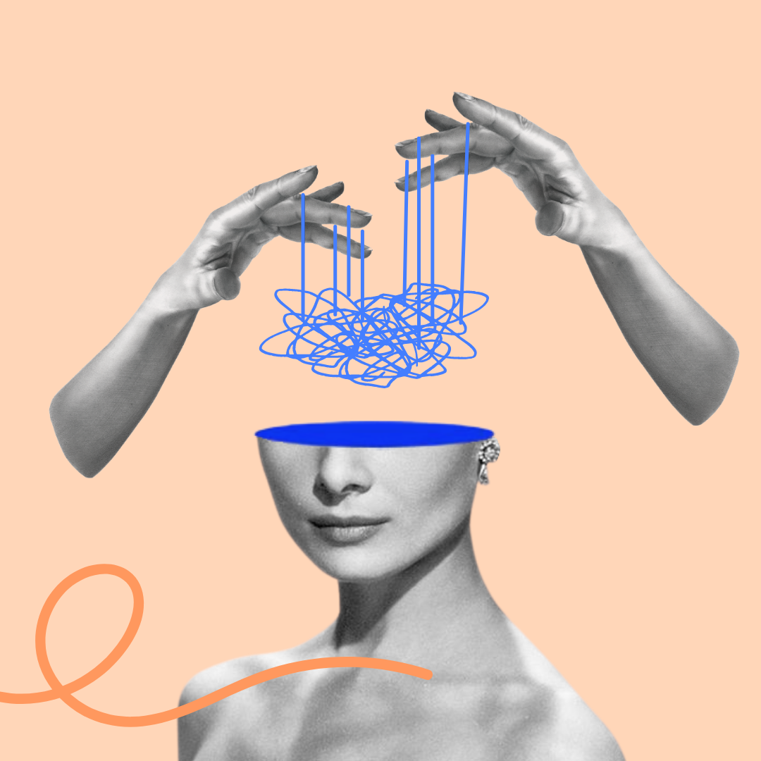



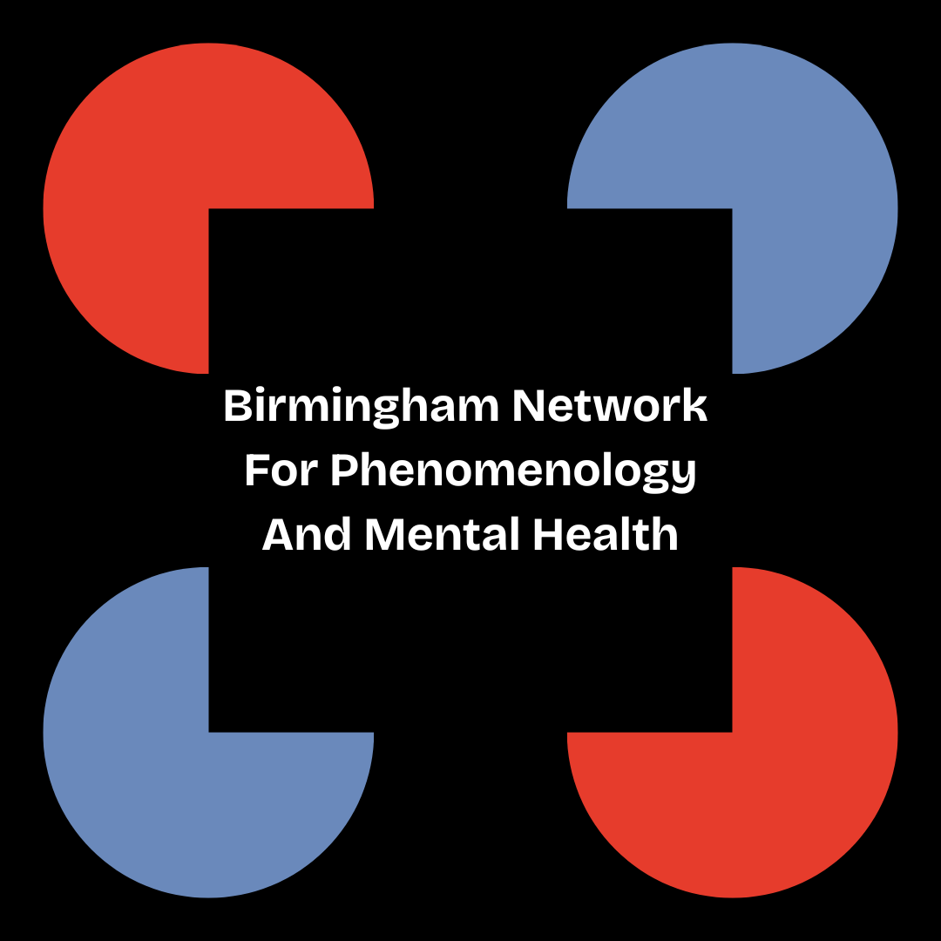

A phenomenological account of Intersectional invisibility in mental illness
Dr Jodie Louise Russell
Research Fellow
Epistemic Injustice in Healthcare project (EPIC)
Birmingham Network for Phenomenology and Mental Health
School of Psychology, University of Birmingham
j.l.russell@bham.ac.uk • @jelliedsours.bsky.social

Slide 2
Introduction
Aim: to consider the phenomenal structure of intersectional invisibility and its impact on mental health research
Overview:
  Young people and psychosis (my case study)
  Introduce intersectional invisibility
  Discuss how experiences of invisibility arise, drawing on Sartre’s distinction between ‘series’ and ‘group’
  Outline the possible consequences this might have for mental health research on intersectional identities

Slide 3

1. Young people and psychosis
Psychosis is a particularly pertinent example of where epistemic injustice may arise
  E.g. due to its characterisation: the ICD-11’s description of “Schizophrenia or other primary psychotic disorders”, as “impaired reality testing”
  The psychosis population is disproportionately represented by individuals from Black, Asian and Minority Ethnic (BAME) backgrounds in England (Public Health England 2016) and internationally (Jongsma et al. 2019)
  Psychosis is a disorder that most frequently manifests in younger men, with the typical age of first episode of psychosis between late teens and early adulthood
Young people with psychosis are therefore likely to experience epistemic injustice as a result of prejudice against multiple features of their identities

Slide 4
1. Young people and psychosis
How do we approach investigating epistemic injustice among young people with psychosis?
An intersectional approach seems important
Epistemic Injustice is not a widely known term; a phenomenological approach will help us identify experiences with the structure of epistemic injustice
However, I looked into intersectional IPA studies, but was dissatisfied with the interview schedules I found (and the lack of resources available!)
Some of the questions were direct
  “Have you ever felt that your gender or race has played a role in missing out on a raise, promotion, and/or key assignment?”
Sometimes to the point of being too complex
  “Tell me about your experiences as a counsellor educator as it relates to your queer, female, and other intersecting identities.”

Slide 5
1. Young people and psychosis
My concerns:
I’m approaching this as an outsider (people might just not like me asking about their identity!)
It assumes one has the language/conceptual tools already to articulate this (many with marginalised identities and mental disorder do not; Spencer 2023)
Assumes in the nature of the questions that these features of their identity are important to them (some people may be of the attitude that it’s ‘just not that deep’)
It possibly excludes people who tentatively identify with particular identity labels
How then do we investigate those with intersectional identities in a mental health context? For me, it starts with thinking about intersectional invisibility…

Slide 6

2. Intersectionality and invisibility
Intersectionality is a term coined by Black feminist thinkers (see Crenshaw 1991; Collins 1990, 2015; Essed 1991) to describe how an individual may face structural discrimination along multiple different axes of their identity
  E.g. gender, race, sexuality, and disability/mental heath
Purdie-Vaughns and Eibach (2008) argue that belonging to multiple group identities can also render individuals invisible with respect to those identities
This is because membership multiple groups might mark you as an ‘atypical’ member with respect to one or more of these groups
  E.g. being a young man with psychosis might make you both an atypical young person (e.g. because of stereotypes of ‘youthfulness’ and ‘carefree’), an atypical mentally ill person (Schizophrenia is not very prevalent compared to other disorders), and an atypical man

Slide 7
2. Intersectionality and invisibility
Invisible in what way?
Purdie-Vaughns and Eibach (2008) refer to being ‘socially invisible’
  Implied that this is invisibility with respect to social structures (e.g. prejudice and discrimination)
  And there can be advantages and disadvantages
    E.g. passing for White might allow someone to escape discrimination/gain access to particular privileges
  These structures are material and habitual
    Social structures aren’t just in the heads of individuals, but refer to the tangible ways in which our lives are structured

Slide 8
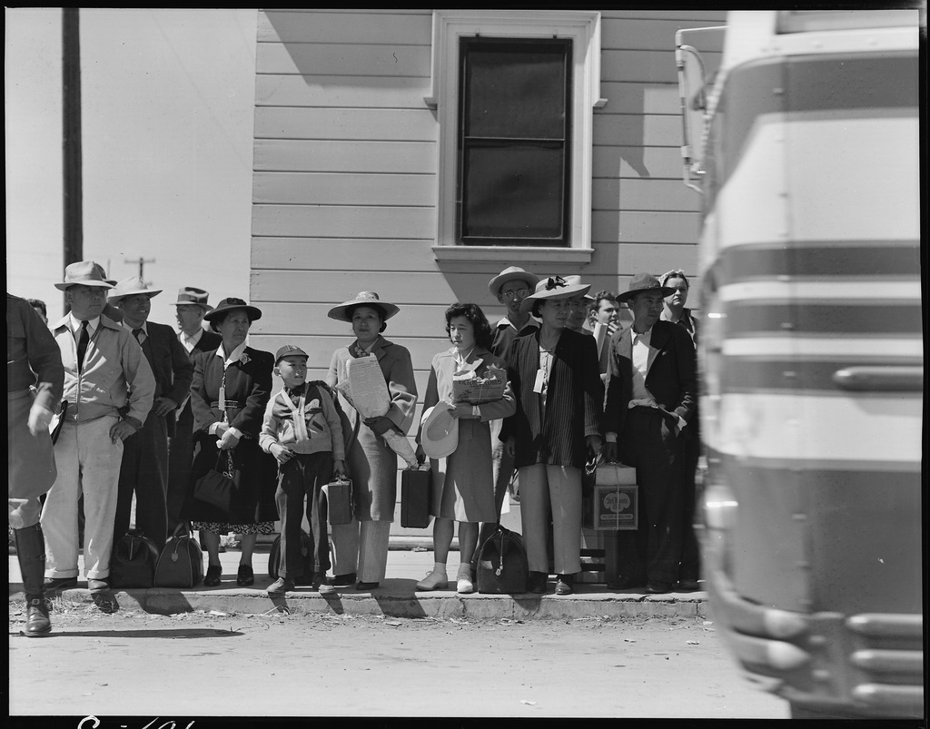
2. Intersectionality and invisibility
Jean-Paul Sartre’s distinction between ‘group’ and ‘series’ in Critique of Dialectical Reason helps to clarify intersectional invisibility:
Series: a passive assemblage of people who have come together because they share a similar, pre-existing social or material situation
  E.g. people waiting for a bus
Group: people undertaking a common goal
  E.g. people protesting poor bus service
A series can morph into a group and vice versa, depending on how (if at all) individuals respond to their shared conditions

Slide 9
2. Intersectionality and invisibility
These terms may also apply to the category ‘mentally ill’:
Individuals may form a series ‘young people with psychosis’ when facing similar historical and social situations
  E.g. they may face similar problems, like stigma, similar choices (therapy or medication), congregate in similar spaces (online, at hospitals) despite differences between them
Likewise, individuals may form a group 'Youth Advisory Group' when actively taking part in a project or goal
  E.g. focus groups, protesting, education, and knowledge exchange
For Young (2008), identity categories like 'women' are series

Slide 10

3. The experience of invisibility
Claim: intersectional individuals aren't just invisible with respect to social structures, they also experience themselves as being invisible within identity groups
What does it mean to ‘feel invisible’?
I think it is a felt tension between the historical/material/social backgrounds that place you in a series with others...
...And the other historical/material/social features that importantly make you different from other members in the series
  I.e. I don't quite feel I belong here and yet I nevertheless share some affinity with the identity ("Yes, I have a mental illness, but it's not my place to weigh-in here")

Slide 11
3. The experience of invisibility
Intersectional invisibility thus creates issues for mental health research:
  Potential participant might then unknowingly rule themselves out (because they can’t rule themselves in)
  They might also not be appropriately offered opportunities to participate (because they aren't 'atypical' cases or its 'too much work' to include them)
Being excluded from group projects in this way also prohibits from individuals taking part in projects that would address that invisibility
  E.g. projects around generating and sharing knowledge (like healthcare care research)
People who experience intersectional invisibility may then be especially prone to hermeneutic injustice (Fricker 2007)

Slide 12

4. The problem of identity
One concern: Sartre's definition of series and group potentially makes identity very broad and inclusive:
  Many things will count as a series
  Any of these may be relevant series from which someone feels invisible
  Any of these might be relevant in prohibiting access to a group ("I support Team X, but everyone else supports Team Y so I don't feel welcome")
Does this make intersectionality trivial?
No, I think this highlights the need to focus on the *various* things that inform/shape identity and experience

Slide 13

Consider ‘series’ from a different perspective…
Sara Ahmed's (2006) metaphor of paths:
  It's very easy to follow the path trodden out in front of you (laid down by many before you)
  It feels almost natural or comfortable to walk down because it is well tread
  But it's not walkable by everyone! And it can be hard to walk through via another path

Slide 14

5. Orientation devices
Ahmed's point is that certain spaces allow certain bodies to pass through with ease, while others cannot
  Bodies that cannot 'pass' might be directed by the path to make them more like the bodies that can, or these kinds of bodies might just be excluded
Things like the path are known as 'orientation devices'; their goal is to make certain bodies appear as invisible in a space (i.e. not conspicuous)
  E.g. queer relationships might take on heterosexual norms to 'fit in'
Orientation devices also extend the capabilities of the body (e.g. universities make research happen), they don’t just ‘collect’ certain bodies together
These are neither passive nor active, but these devices 'orientate' in virtue of being habitual

Slide 15
5. Orientation devices
Ahmed's account is useful because it helps us to understand how series can be organised (non-trivially) around all kinds of institutions, people and objects
  Moreover, she adds that this organisation matters; it allows us to do some things and not others
Young people with psychosis might be recruited to the study, so they have the opportunity to contribute, but certain habitual factors prohibit their participation
  In other words, certain engrained habits of doing things mean that they don’t have the same agency as other people in their social groups
  This might mean that they don't feel represented/heard/included
And they might attribute their feelings invisibility to features not directly relevant to these demographic categories
  e.g., being an only child, having divorced parents, being a pet owner

Slide 16
6. Conclusions
Individuals with psychosis are likely to have highly intersectional identities (and feel excluded from some groups on the basis on that intersectionality)
This is a problem for mental health research
One way to characterise heteronomous identity groups is through the notion of series
It's possible that all series eventually boil down to the main 'big' categories (race, gender, class, sexuality etc.)
But I think this could be overly reductive and possibly alienating for those with intersectional invisibility
For some, identity might just not be very salient at all (over-intellectualising) and thus it may be more valuable to consider what material and habitual features of our world organise people’s lives (and what might be prohibiting them from accessing particular things, like research)
My take: interpret identity widely, and let the participant tell you who they are on their own terms

Slide 17

Thank you!
Contact: j.l.russell@bham.ac.uk or @jelliedsours.bsky.social
References:
Ahmed, S. (2006), Queer Phenomenology: Orientations, Objects, Others. Duke University Press
Collins, P. H., (1990), “Black feminist thought in the matrix of domination”, Black feminist thought: Knowledge, consciousness, and the politics of empowerment, 138(1990), pp.221-238.
Crenshaw, K., (1991) “Mapping the Margins: Intersectionality, Identity Politics, and Violence Against Women of Color”, Stanford Law Review, 43(6), pp.1241-1299.
Crichton, P., Carel, H. and Kidd., I. J., (2017), “Epistemic injustice in psychiatry”, BJPsych Bulletin, pp.41-65.
Essed, P., (1991), Understanding Everyday Racism: An Interdisciplinary Theory, Sage Series on Race and Ethnic Relations Vol. 2, (ed.) John H. Stanfield II, Sage: Newbury Park, London, New Delhi.
Fricker, M., (2007), Epistemic Injustice: Power and the Ethics of Knowing, Oxford University Press.
Public Health England, (2016), “Psychosis data report”, [Online] Available: https://www.gov.uk/government/publications/psychosis-data-report [Accessed 29/10/2024]
Purdie-Vaughns, V. and Eibach, R.P., (2008), “Intersectional invisibility: The distinctive advantages and disadvantages of multiple subordinate-group identities”, Sex Roles, 59, pp.377-391.
Sartre, J-P., (1976), Critique of Dialectical Reason, NLB: London
Young, I.M., (2008), “Gender as seriality”, Feminist Interpretations of Jean Paul Sartre, pp.200-28.

