Slide 1






Sartre and Psychosis
Doing intersectional, phenomenological interviews with people with experience of mental disorder
Dr Jodie Louise Russell
Research Fellow
Epistemic Injustice in Healthcare project (EPIC)
Birmingham Network for Phenomenology and Mental Health
School of Psychology, University of Birmingham
j.l.russell@bham.ac.uk • @jelliedsours.bsky.social

Slide 2
Introduction
Aim: to find a method for investigating intersectionality in qualitative interviews (with young people with psychosis)
Overview:
  Young people and psychosis (my case study)
  Sartre’s distinction between ‘series’ and ‘group’ for a new take on identity
  Outline a possible new method for mental health research on intersectional identities

Slide 3

1. Young people and psychosis
Psychosis is a particularly pertinent example of where epistemic injustice may arise
  E.g. due to its characterisation: the ICD-11’s description of “Schizophrenia or other primary psychotic disorders”, as “impaired reality testing”
  The psychosis population is disproportionately represented by individuals from Black, Asian and Minority Ethnic (BAME) backgrounds in England (Public Health England 2016) and internationally (Jongsma et al. 2019)
  Psychosis is a disorder that most frequently manifests in younger men, with the typical age of first episode of psychosis between late teens and early adulthood
Young people with psychosis are therefore likely to experience epistemic injustice as a result of prejudice against multiple features of their identities

Slide 4

1. Young people and psychosis
Why is this important to consider in healthcare research?
Purdie-Vaughns and Eibach (2008) argue that belonging to multiple group identities can also render individuals invisible with respect to those identities
This is because membership multiple groups might mark you as an ‘atypical’ member with respect to one or more of these groups
  E.g. being a young man with psychosis might make you both an atypical young person (e.g. because of stereotypes of ‘youthfulness’ and ‘carefree’), an atypical mentally ill person (Schizophrenia is not very prevalent compared to other disorders), and an atypical man

Slide 5
1. Young people and psychosis
Intersectional invisibility thus creates issues for mental health research:
  Potential participant might then unknowingly rule themselves out (because they can’t rule themselves in)
  They might also not be appropriately offered opportunities to participate (because they aren't 'atypical' cases or its 'too much work' to include them)
Being excluded from group projects in this way also prohibits from individuals taking part in projects that would address that invisibility
  E.g. projects around generating and sharing knowledge (like healthcare care research)
People who experience intersectional invisibility may then be especially prone to hermeneutic injustice (Fricker 2007)

Slide 6

1. Young people and psychosis
How do we approach investigating epistemic injustice among young people with psychosis?
An intersectional approach seems important
Epistemic Injustice is not a widely known term; a phenomenological approach will help us identify experiences with the structure of epistemic injustice
However, I looked into intersectional IPA studies but was dissatisfied with the interview schedules I found (and the lack of resources available!)
Some of the questions were direct
  “Have you ever felt that your gender or race has played a role in missing out on a raise, promotion, and/or key assignment?”
Sometimes to the point of being too complex
  “Tell me about your experiences as a counsellor educator as it relates to your queer, female, and other intersecting identities.”

Slide 7
1. Young people and psychosis
My concerns:
I’m approaching this as an outsider (people might just not like me asking about their identity!)
It assumes one has the language/conceptual tools already to articulate this (many with marginalised identities and mental disorder do not; Spencer 2023)
Assumes in the nature of the questions that these features of their identity are important to them (some people may be of the attitude that it’s ‘just not that deep’)
It possibly excludes people who tentatively identify with particular identity labels
How then do we investigate those with intersectional identities in a mental health context?

Slide 8

2. Sartre and series identity
Jean-Paul Sartre’s distinction between ‘group’ and ‘series’ in Critique of Dialectical Reason gives us a more useful concepts of identity to work with:
Series: a passive assemblage of people who have come together because they share a similar, pre-existing social or material situation
  E.g. people waiting for a bus
Group: people undertaking a common goal
  E.g. people protesting poor bus service
A series can morph into a group and vice versa, depending on how (if at all) individuals respond to their shared conditions

Slide 9
2. Sartre and series identity
These terms may also apply to the category ‘mentally ill’:
Individuals may form a series ‘young people with psychosis’ when facing similar historical and social situations
  E.g. they may face similar problems, like stigma, similar choices (therapy or medication), congregate in similar spaces (online, at hospitals) despite differences between them
Likewise, individuals may form a group 'Youth Advisory Group' when actively taking part in a project or goal
  E.g. focus groups, protesting, education, and knowledge exchange
For Young (2008), identity categories like 'women' are series

Slide 10
2. Sartre and series identity
The strengths of this view:
Series and group identity is fluid; people move in and out of their groups and series
We can have identity without Identity™
  We might call series identity loose ‘affiliation’ or ‘kinship’
  This may be more faithful to the phenomenology of identification
The series we belong to will be varied, diverse and overlapping
  This captures intersectionality in a complex way as well as the variety of identities which matter to people that are not covered well in demographic forms (e.g. being an only child, being a pet owner)
  It is also non-trivial; many things matter to us and shape who we are

Slide 11
3. The method
Developed from Cachia (2023), “Examining Processes Using The Lifeline Interview Technique: A researcher’s note”
Presenting your whole life as a narrative can be tricky; I decided to start small with just an overview of the participant’s week:
“The aim of this interview is to get an overview of who you are as a person, what kinds of groups and communities you are a part of and what your conversations about your mental health, if any, are like.
To start, we will carry out an exercise to get a shape of your day-to-day life. This will involve drawing a timeline representing your week, starting on Monday and ending on Sunday. Mark on the timeline the typical things you might do each day. It doesn’t matter if you don’t do them every week, or if you haven’t done them for a little while.
You can draw or write to represent anything significant that happens as part of your routine, including places you go, things you do, anything you enjoy or anything you don’t. In particular, make a note of people you meet or spend time with (e.g. friends, family, work colleagues, even pets!)
If it is easier, draw a timeline for what you did last week.”

Slide 12

3. The method
Aim: to get an overview of some of the participant’s series and groups
Rational: we participate in the series and groups that are meaningful to us on a semi-regular basis
We can then uncover in the interview how the participant experiences ‘belongingness’ in those groups…
  “Can you give me an example of when your mental health has had an impact on one of your day-to-day activities?”
… and consequently where epistemic injustice occurs
  My working assumption is that epistemic injustice is socially alienating

Slide 13
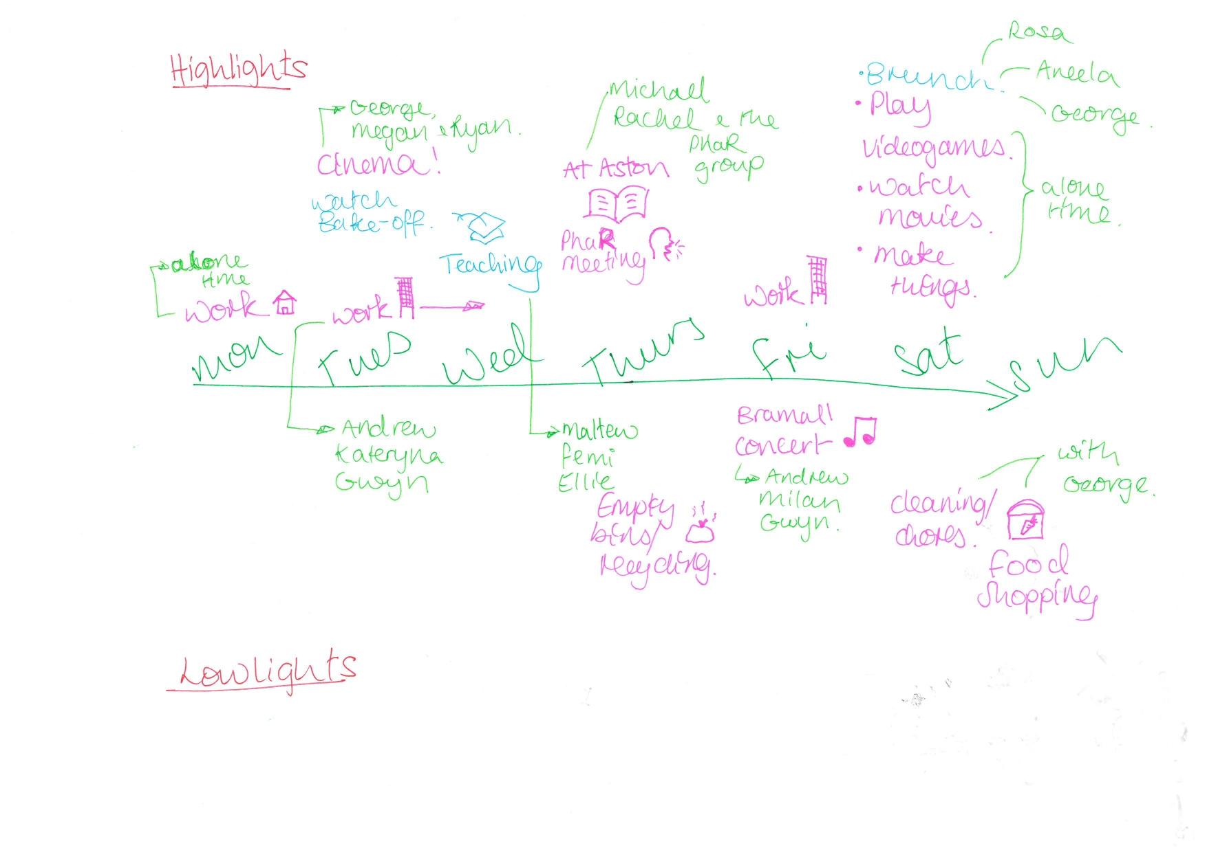
3. The method

Slide 14

4. Conclusions
Individuals with psychosis are likely to have highly intersectional identities (and feel excluded from some groups on the basis on that intersectionality)
This is a problem for mental health research
One way to characterise heteronomous identity groups is through the notion of series
My take: interpret identity widely, and let the participant tell you who they are on their own terms
This can be achieved in interviews with techniques like timelines/narrative lifelines

Slide 15

Thank you!
Contact: j.l.russell@bham.ac.uk or @jelliedsours.bsky.social
References:
Cachia, M., (2023), “Examining Processes Using The Lifeline Interview Technique: A researcher’s note”, pre-print.
Fricker, M., (2007), Epistemic Injustice: Power and the Ethics of Knowing, Oxford University Press.
Public Health England, (2016), “Psychosis data report”, [Online] Available: https://www.gov.uk/government/publications/psychosis-data-report [Accessed 29/10/2024]
Purdie-Vaughns, V. and Eibach, R.P., (2008), “Intersectional invisibility: The distinctive advantages and disadvantages of multiple subordinate-group identities”, Sex Roles, 59, pp.377-391.
Sartre, J-P., (1976), Critique of Dialectical Reason, NLB: London
Young, I.M., (2008), “Gender as seriality”, Feminist Interpretations of Jean Paul Sartre, pp.200-28.

