Slide 1
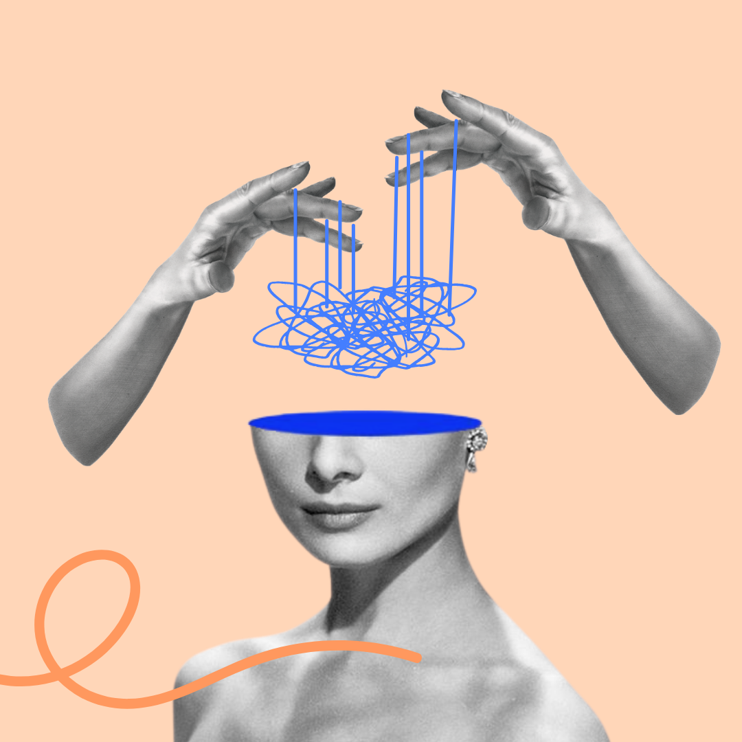



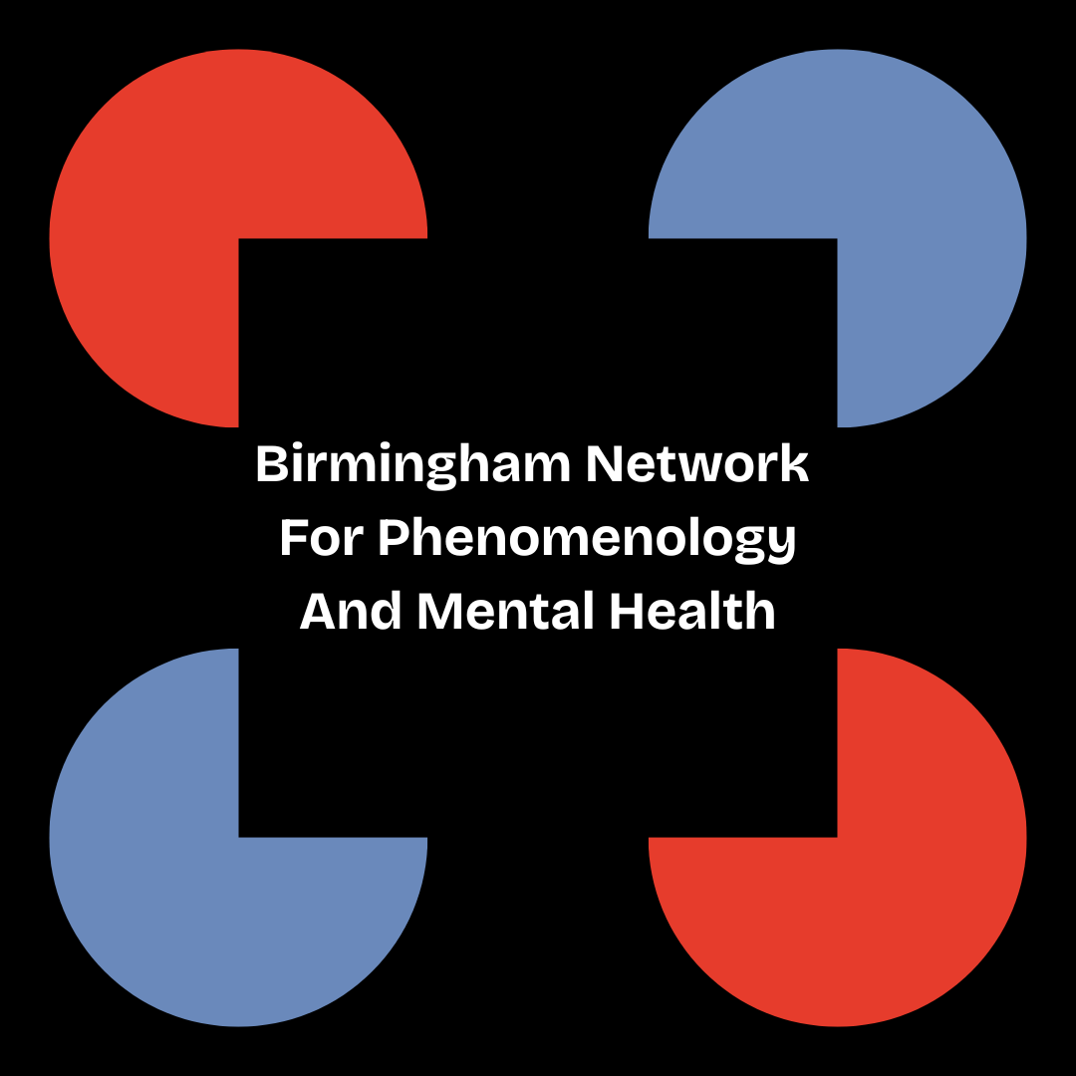

Young People with Psychosis at the Intersection of Identities
Dr Jodie Louise Russell
Research Fellow
Epistemic Injustice in Healthcare project (EPIC)
Birmingham Network for Phenomenology and Mental Health
School of Psychology, University of Birmingham
j.l.russell@bham.ac.uk • @jelliedsours.bsky.social

Slide 2

Introduction
Aim: to consider some theoretical implications of intersectionality on the forthcoming EPIC case study
Overview:
  Background on epistemic injustice and young people with psychosis
  Intersectionality and invisibility
  Problems for mental health research

Slide 3

1. Young people and psychosis
Patients often feel that clinicians, and even their loved ones, don’t listen to their experiences or take their reports seriously
A lack of credibility afforded to patient testimony can often lead to harm
  For example: misdiagnosis, over pathologization or under-pathologization, a failing trust in healthcare professionals or the patient themselves, and inadequate or inappropriate treatment
The phenomenon of discrediting patient experience based on prejudice is a form of epistemic injustice (Fricker 2007)
Two main types:
  Testimonial injustice: where an individual is harmed due to being treated as an inadequate knower in a given situation
  Hermeneutic injustice: where individuals are excluded from using particular concepts to understand their experiences or are unable to contribute concepts of their own

Slide 4
1. Young people and psychosis
Psychosis is a particularly pertinent example of where epistemic injustice may arise due to its characterisation
  E.g. the ICD-11’s description of “Schizophrenia or other primary psychotic disorders”, as “impaired reality testing”
The psychosis population is disproportionately represented by individuals from Black, Asian and Minority Ethnic (BAME) backgrounds in England (Public Health England 2016) and internationally (Jongsma et al. 2019)
Psychosis is a disorder that most frequently manifests in younger men, with the typical age of first episode of psychosis between late teens and early adulthood
Young people with psychosis are therefore likely to experience epistemic injustice as a result of prejudice against multiple features of their identities

Slide 5
1. Young people and psychosis
Work has also already been done to theorise cases of epistemic injustice among young people with psychosis in particular (see Houlders, Bortolotti, and Broome 2021)
  There is preliminary empirical evidence supporting the analysis that young people in particular experience epistemic injustice (see Greenblat et al. 2024).
Baumtrog and Peach (2019): children are discredited or ignored due to presuppositions that children engage in creative fantasy, roleplaying and lying, and therefore may not be trusted and presuppositions that children simply know less and have inadequate experience compared to adults.
  Such attitudes are described as ‘adultcentrism’, the perspective that the adult experience should be the centre and measure for such things as knowledge
However, the intersectional aspect to young people’s experiences of epistemic injustice has not yet been thoroughly investigated

Slide 6

2. Intersectionality and invisibility
Intersectionality is a term coined by Black feminist thinkers (see Crenshaw 1991; Collins 1990, 2015; Essed 1991) to describe how an individual may face structural discrimination along multiple different axes of their identity
  E.g. gender, race, sexuality, and disability/mental heath
Purdie-Vaughns and Eibach (2008) argue that belonging to multiple group identities can also render individuals invisible with respect to those identities
This is because membership multiple groups might mark you as an ‘atypical’ member with respect to one or more of these groups
  E.g. being a young man with psychosis might make you both an atypical young person (e.g. because of stereotypes of ‘youthfulness’ and ‘carefree’) and atypical mentally ill person (Schizophrenia is not very prevalent compared to other disorders)

Slide 7
2. Intersectionality and invisibility
Invisible in what way?
Purdie-Vaughns and Eibach (2008) refer to being ‘socially invisible’
  Implied that this is invisibility with respect to social structures (e.g. prejudice and discrimination)
  And there can be advantages and disadvantages
    E.g. passing for White might allow someone to escape discrimination/gain access to particular privileges
  This will also be material
    Social structures aren’t just in the heads of individuals, but refer to the tangible ways in which our lives are structured

Slide 8
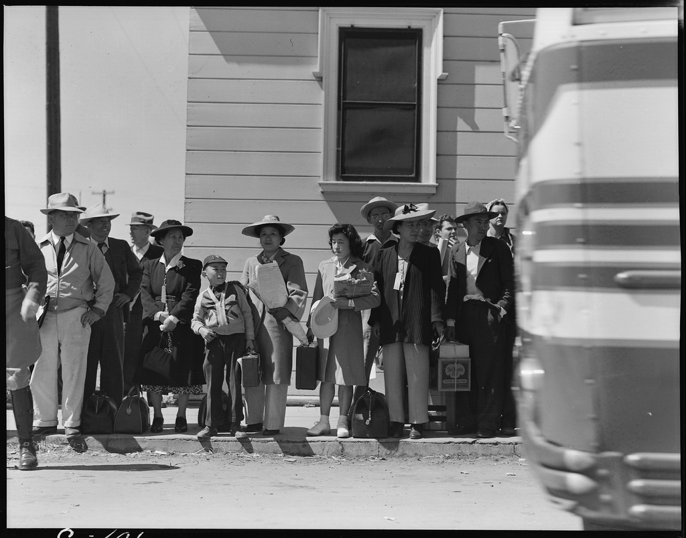
2. Intersectionality and invisibility
Jean-Paul Sartre’s distinction between ‘group’ and ‘series’ in Critique of Dialectical Reason helps to clarify intersectional invisibility:
Series: a passive assemblage of people who have come together because they share a similar, pre-existing social or material situation
  E.g. people waiting for a bus
Group: people undertaking a common goal
  E.g. people protesting poor bus service
A series can morph into a group and vice versa, depending on how (if at all) individuals respond to their shared conditions

Slide 9
2. Intersectionality and invisibility
These terms may also apply to the category ‘mentally ill’:
Individuals may form a series ‘mentally ill’ when facing similar historical and social situations
  E.g. they may face similar problems, like stigma, similar choices (therapy or medication), congregate in similar spaces (online, at hospitals) despite differences in diagnosis
Likewise, individuals may form a group ‘young people with psychosis’ when actively taking part in a project or goal
  E.g. focus groups, protesting, education, and knowledge exchange

Slide 10

3. A problem for intersectional research
Intersectional invisibility can occur when individuals are prohibited from transitioning from series to group, i.e. they are barred from taking part in projects, because of the other series/groups to which they belong
Different series/groups will vary in their material and historical conditions, and this can ‘complicate’ participation in group projects
  E.g. young people with psychosis might not be able to participate in research on patient-clinician interactions because, for example, they don’t have the time/money for travel
  They also might not be invited to contribute despite being patients or service users (because of perceived naïveté)
  In this way, young people might not ‘typify’ a patient group; they can’t participate in the same projects, or in the same ways, and so may feel invisible with respect to those projects
  They might then feel unwelcome and that the research ‘isn’t about them’

Slide 11
3. A problem for intersectional research
Being barred from group projects in this way also prohibits from individuals taking part in projects that would address that invisibility
  E.g. projects around generating and sharing knowledge (like research)
People who experience intersectional invisibility may then be especially prone to hermeneutic injustice (Fricker 2007)
Intersectional invisibility might be difficult to research itself:
  Potential participant might then unknowingly rule themselves out (because they can’t rule themselves in)
  Being barred from certain group activities (like knowledge exchange) might mean that individuals lack useful concepts for self-understanding
Ask me in the Q&A how we are incorporating considerations about intersectionality in the case study

Slide 12

Thank you!
Contact: j.l.russell@bham.ac.uk or @jelliedsours.bsky.social
References:
Baumtrog, M.D. and Peach, H., (2019), “They can't be believed: children, intersectionality, and epistemic injustice”, Journal of Global Ethics, 15(3), pp.213-232.
Collins, P. H., (1990), “Black feminist thought in the matrix of domination”, Black feminist thought: Knowledge, consciousness, and the politics of empowerment, 138(1990), pp.221-238.
Crenshaw, K., (1991) “Mapping the Margins: Intersectionality, Identity Politics, and Violence Against Women of Color”, Stanford Law Review, 43(6), pp.1241-1299.
Crichton, P., Carel, H. and Kidd., I. J., (2017), “Epistemic injustice in psychiatry”, BJPsych Bulletin, pp.41-65.
Essed, P., (1991), Understanding Everyday Racism: An Interdisciplinary Theory, Sage Series on Race and Ethnic Relations Vol. 2, (ed.) John H. Stanfield II, Sage: Newbury Park, London, New Delhi.
Fricker, M., (2007), Epistemic Injustice: Power and the Ethics of Knowing, Oxford University Press.
Greenblatt, A., Lee, E., Ashcroft, R. and Muskat, B., (2024), “Epistemic justice and injustice among youth with mental health concerns”, Children & Society, 38(4), pp.1039-1058.
Houlders, J.W., Bortolotti, L. and Broome, M.R., (2021), “Threats to epistemic agency in young people with unusual experiences and beliefs”, Synthese, 199(3), pp.7689-7704.
Jongsma, H. E., Turner C., Kirkbride J. B., Jones P. B., (2019), “International incidence of psychotic disorders, 2002-17: a systematic review and meta-analysis”, Lancet Public Health, 2019 May; 4(5):e229-e244. doi: 10.1016/S2468-2667(19)30056-8
Public Health England, (2016), “Psychosis data report”, [Online] Available: https://www.gov.uk/government/publications/psychosis-data-report [Accessed 29/10/2024]
Purdie-Vaughns, V. and Eibach, R.P., (2008), “Intersectional invisibility: The distinctive advantages and disadvantages of multiple subordinate-group identities”, Sex Roles, 59, pp.377-391.
Sartre, J-P., (1976), Critique of Dialectical Reason, NLB: London

