Slide 1
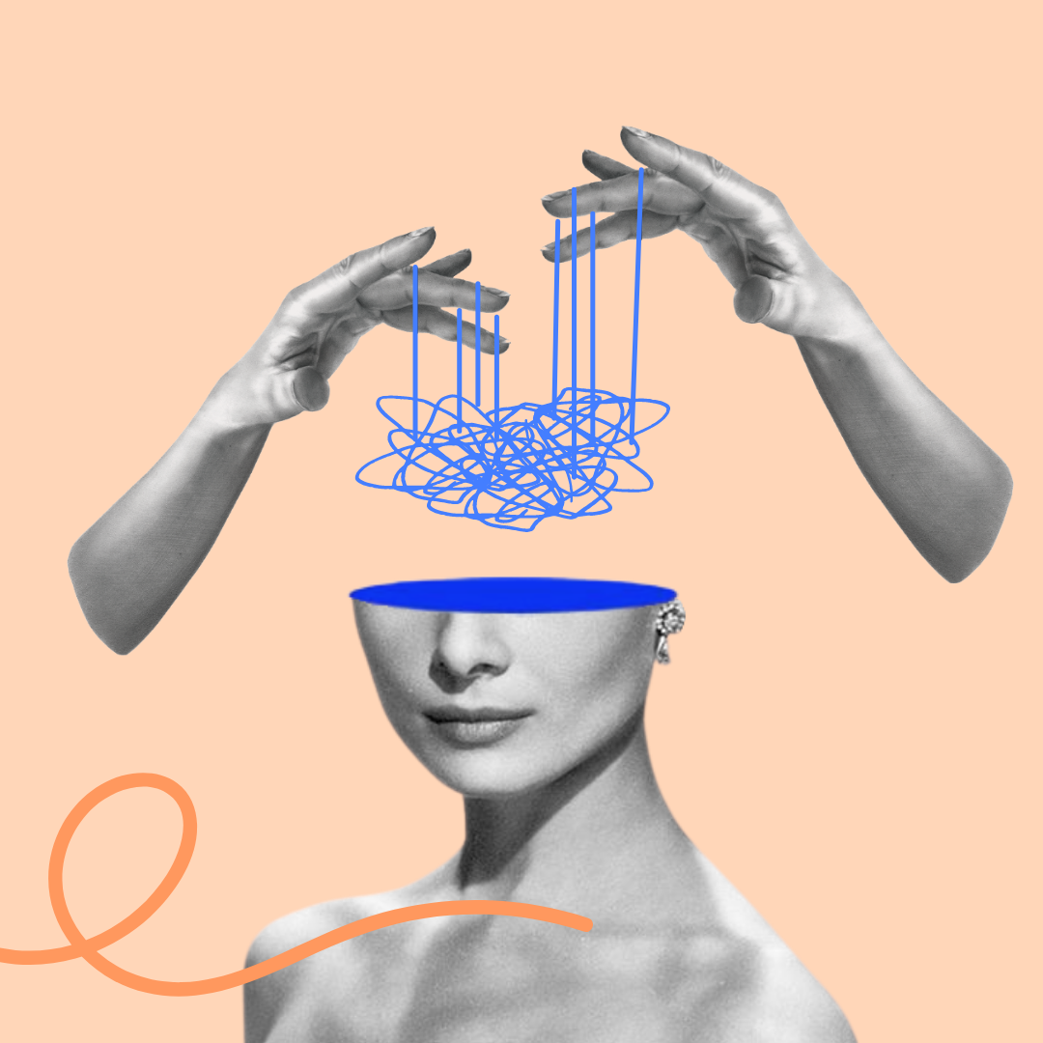



Intersectional invisibility and its impact on belongingness and being understood
Dr Jodie Louise Russell
Research Fellow, Epistemic Injustice in Healthcare project (EPIC)
School of Psychology, University of Birmingham
j.l.russell@bham.ac.uk • @jelliedsours.bsky.social

Slide 2

Introduction
Aim: to theorize the impact of intersectional invisibility feelings of belongingness and being understood for those with mental disorder, as well as its consequences for qualitative research
Route:
  Introduce intersectional invisibility
  Discuss how experiences of invisibility arise, drawing on Fricker’s notion of hermeneutic injustice and Sartre’s distinction between ‘series’ and ‘group’
  Suggest that this results in subsequent feelings of not belonging, being misunderstood and not understanding oneself
  Outline the possible consequences this might have for mental health research

Slide 3

1. Intersectional invisibility
Intersectionality is a term coined by Black feminist thinkers (see Crenshaw 1991; Collins 1990, 2015; Essed 1991) to describe how an individual may face structural discrimination along multiple different axes of their identity
  E.g. gender, race, sexuality, and disability/mental heath
Purdie-Vaughns and Eibach (2008) argue that belonging to multiple group identities can also render individuals invisible with respect to those identities
This is because membership multiple groups might mark you as an ‘atypical’ member with respect to one or more of these groups
  E.g. being a man with mental illness might make you both an atypical man (because being mentally ill makes you vulnerable) and atypical mentally ill person (people with mental illness don’t often have privilege)
  Another example: “you can’t be rich and mentally ill”

Slide 4
1. Intersectional invisibility
Invisible in what way?
Purdie-Vaughns and Eibach (2008) refer to being ‘socially invisible’
  Implied that this is invisibility with respect to social structures (e.g. prejudice and discrimination)
  This visibility could be literal (individuals aren’t ‘seen’ to belong to a group by others) or conceptual (individuals aren’t part of the ‘social imaginary’ of a group)
  And there can be advantages and disadvantages
  I want to claim that this is also phenomenological; individuals feel invisible, and thus lack a sense of belonginess or understanding

Slide 5

2. The experience of invisibility
Claim: individuals who belong to more than one marginalised group identity experience themselves as being invisible within those groups
What does it mean to ‘feel invisible’?
To feel like the group doesn’t represent me
To feel like one does not belong
To feel like the group identity doesn’t fit me
And yet I am nevertheless part of this group
The latter point is important as it is what separates someone who is ‘invisible’ from someone who rejects a misapplied identity

Slide 6
2. The experience of invisibility
How do we make sense of this experience? Jean-Paul Sartre’s distinction between ‘group’ and ‘series’ in Critique of Dialectical Reason will help:
A series is a passive assemblage of people who have come together because they share a similar, pre-existing social or material situation
  E.g. people waiting for a bus
A group, instead, involves people undertaking a common goal
  E.g. people protesting poor bus service
A series can morph into a group and vice versa, depending on how (if at all) individuals respond to their shared conditions

Slide 7
2. The experience of invisibility
These also map onto two different phenomenal experiences of identity:
In a series, one may feel an association and see much in common with others in terms of our situation but a ‘strong’ sense of identity might not be something endorsed
  It would be weird, for example, to declare “I am a bus traveller” but that doesn’t mean I feel disassociated from others I travel with
In a group, I may feel identity in the strong sense because I am aware of and/or endorse our shared project
  It wouldn’t be weird to declare “I am a protestor”, but it would be weird to then cross the picket line!

Slide 8
2. The experience of invisibility
These terms may also apply to the category ‘mentally ill’:
Individuals may form a series ‘mentally ill’ when facing similar historical and social situations
  E.g. they may face similar problems, like stigma, similar choices (therapy or medication), congregate in similar spaces (online, at hospitals)
Likewise, individuals may form a group ‘mentally ill’ when actively taking part in a project or goal
  E.g. focus groups, clinical trials, protesting, education and knowledge exchange
Individuals with mental illness may then experience different kinds of belongingness depending on whether they are part of a group or series

Slide 9
2. The experience of invisibility
Intersectional invisibility can occur when individuals are prohibited from transitioning from series to group, i.e. they are barred from taking part in projects
And they are prohibited because of the other series/groups to which they belong
Different series/groups will vary in their social and historical backdrops, and this can ‘complicate’ participation in group projects
  E.g. men with mental illness may have to deal with patriarchal structures that don’t allow them to, for example, express emotion or vulnerability (which may be necessary for participating in mental illness ‘projects’ like raising awareness)
  In this way, men might not ‘typify’ the mentally ill group; they can’t participate in the same projects, or in the same ways, and so may feel invisible with respect to those projects

Slide 10
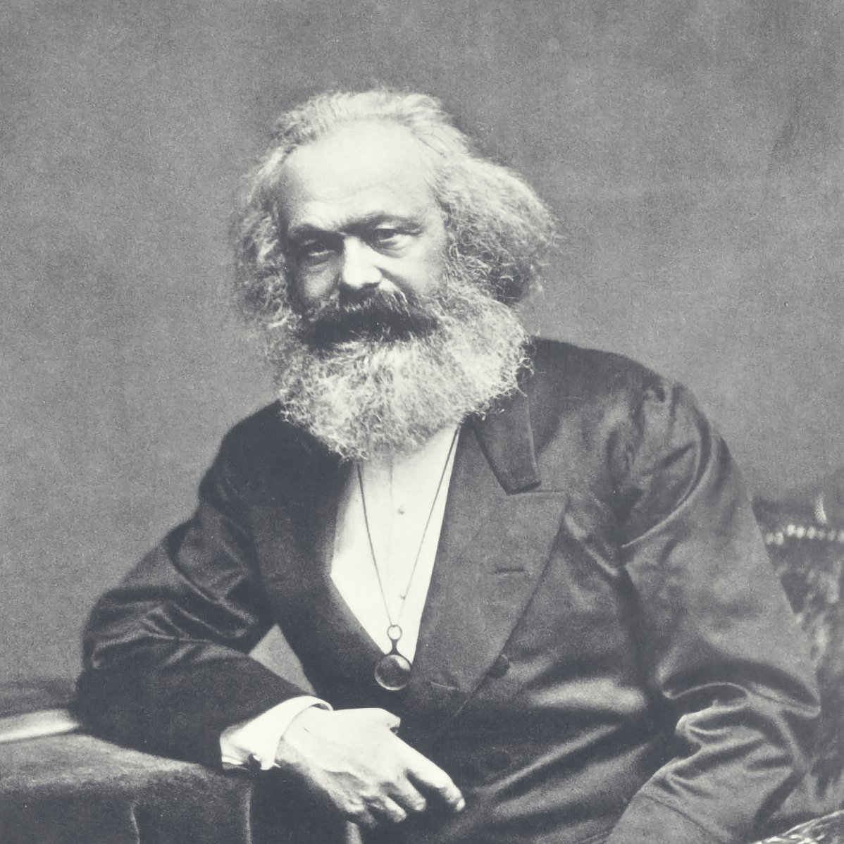
3. Belongingness and Understanding
The consequence of intersectional invisibility (and being barred from group-level projects) is that individuals will feel that they don’t truly belong to these identity groups
However, the fact of their sharing similar social and material situations means that they may nevertheless be thrown into a series with others
  The mentally unwell man may face similar struggles (e.g. with dealing with work-related stress) but cannot move into the group level to address those conditions
  This creates an alienated feeling of belonging
But, this isn’t the only bad consequence; being barred from these projects also prohibits from individuals taking part in projects that would address that alienation
  E.g. projects around generating and sharing knowledge

Slide 11
3. Belongingness and Understanding
People who experience intersectional invisibility may then be especially prone to hermeneutic injustice (Fricker 2007)
  This is where individuals lack conceptual tools to understand their experiences or are prohibited from contributing their knowledge to the conceptual toolset available
If mentally unwell men, for example, cannot form part of the group ‘mentally ill individuals’ because of their status as men, then they also cannot access and contribute to knowledge around mental health
  That’s not to say that the group ‘mentally ill individuals’ are discriminatory against men and won’t let them contribute, but there is something about the social and material conditions of masculinity (e.g. the reality of patriarchy) that prohibits men from contributing
Mentally ill men, then, may not just feel alienated and lack a sense of belonging, but also be unable to access the conceptual tools to understand themselves as mentally unwell, and the tools needed to address the harms of the patriarchy

Slide 12
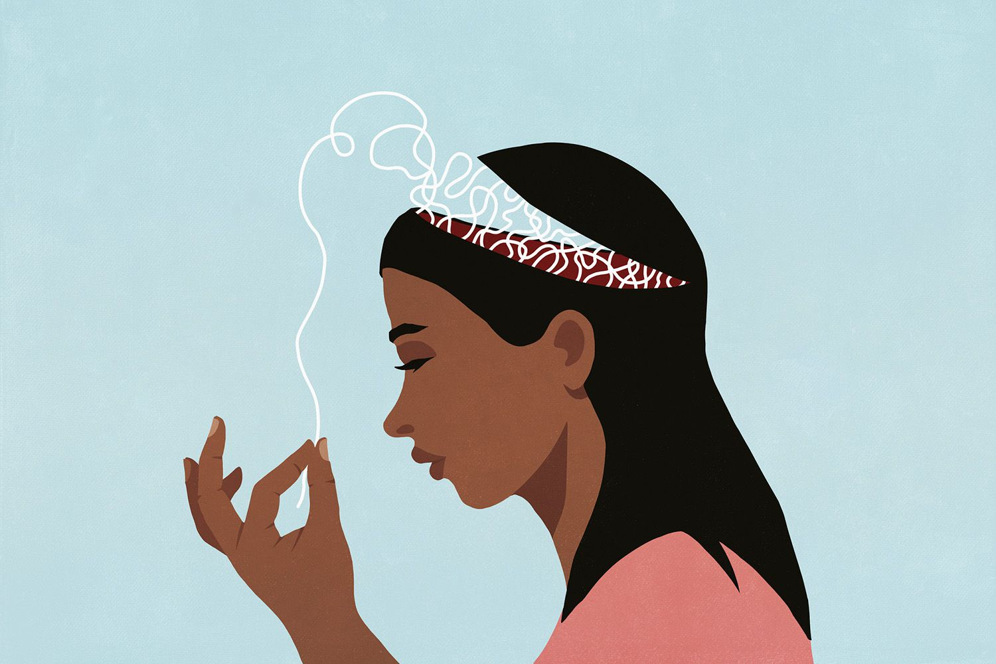
4. Impact on MH Research
Intersectional invisibility presents some potential problems when conducting MH research itself:
  Participants might not fully identify with a particular label despite meeting its criteria
    This might mean their relationship with the ‘group’ or ‘series’ is fraught and itself a source of distress
    Excluding participants without clear identification, however, may mean we only research the experiences of those that are seen to ‘typify’ the group
    May also mean that the only participants that ‘sign up’ are those that typify the group
    Intersectionally invisible participants might not then get the opportunity to contribute knowledge
  Participants may also lack some understanding regarding their identity, simply because they have been prohibited access to particular knowledge or concepts
    They may also get their knowledge from other sources, which aren’t ‘standard’ for the group (e.g. from religious beliefs, or from online communities)
    Potential participant might then unknowingly rule themselves out (because they can’t rule themselves in)
    Lived experience might be difficult to investigate with intersectionally invisible participants (not because their experiences aren’t shared with others, but because they are hermeneutically marginalised)

Slide 13
Thank you!
Contact: j.l.russell@bham.ac.uk or @jelliedsours.bsky.social
References:
Collins, P. H., (1990), “Black feminist thought in the matrix of domination”, Black feminist thought: Knowledge, consciousness, and the politics of empowerment, 138(1990), pp.221-238.
Crenshaw, K., (1991) “Mapping the Margins: Intersectionality, Identity Politics, and Violence Against Women of Color”, Stanford Law Review, 43(6), pp.1241-1299.
Crichton, P., Carel, H. and Kidd., I. J., (2017), “Epistemic injustice in psychiatry”, BJPsych Bulletin, pp.41-65.
Essed, P., (1991), Understanding Everyday Racism: An Interdisciplinary Theory, Sage Series on Race and Ethnic Relations Vol. 2, (ed.) John H. Stanfield II, Sage: Newbury Park, London, New Delhi.
Fricker, M., (2007), Epistemic Injustice: Power and the Ethics of Knowing, Oxford University Press.
Purdie-Vaughns, V. and Eibach, R.P., (2008), “Intersectional invisibility: The distinctive advantages and disadvantages of multiple subordinate-group identities”, Sex Roles, 59, pp.377-391.
Sartre, J-P., (1976), Critique of Dialectical Reason, NLB: London
Young, I.M., (2008), “Gender as seriality”, Feminist Interpretations of Jean Paul Sartre, pp.200-28.

