Slide 1



Communicating Ineffable Experiences: a way forward with phenomenology
Dr Jodie Louise Russell
Research Fellow, Epistemic Injustice in Healthcare project (EPIC)
School of Psychology, University of Birmingham
j.l.russell@bham.ac.uk • @jelliedsours

Slide 2
Introduction
Aim: to account for how is possible to understand experiences of mental disorder for researchers and clinicians without lived experience
Route: this will involve developing a phenomenology of language and applying this to the domain of mental disorder
Additionally, this will involve overcoming particular challenges in understanding (to be addressed)

Slide 3
Overview
What is phenomenology and why does it matter?
  Brief overview of key concepts
What are the barriers to understanding lived experience?
  The communicative dead-end
  The problem of problematic empathy
  The unworlding nature of disorder experience
How can these problems be overcome?
  Through a phenomenological understanding of how language and communication works
  An account developed here from Heidegger and Merleau-Ponty
Notes:
End with some take-aways

Slide 4

1. What is phenomenology and why does it matter?
Phenomenology: the study of structures of experience
It tries to get at the heart of why things appear to us in the way that they do
  E.g. why the apple appears to us as red, round, delicious (even tempting?)
More than mere sense-experience; can also include the significance of objects
This is from a first-person perspective
  E.g. why does the apple appear to me in this way
Experience is directed towards the world can be directed in different ways
  These can depend on my body, culture, skills, habits, and social background

Slide 5

1. What is phenomenology and why does it matter?
A key insight of the phenomenological psychopathology movement is that lived experience is sometimes ignored/overlooked in mental health settings
  Bias towards examining behaviour
This is problematic insofar as our interpretations of someone’s behaviour may not match how it is actually experienced
Ignoring the reports of lived experience can result in epistemic injustice (see Fricker 2007)
  Where an individual is harmed because their knowledge is deemed to be less credible

Slide 6
2. What are the barriers to understanding lived experience?
If we want to be good phenomenologists, we should try and understand what is it like to have that disorder
However, disorder experience can be hard to understand if you haven’t experienced it yourself
How do we, as researchers and individuals in clinical spaces, understand these complex experiences?

Slide 7
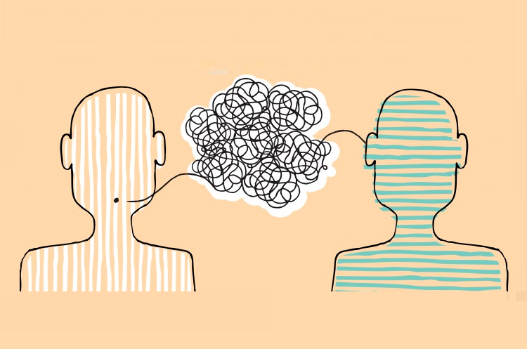
2. What are the barriers to understanding lived experience?
First, I would label 3 key problems to understanding disorder experience:
  The communicative dead-end
  The problem of problematic empathy
  The unworlding nature of disorder experience

Slide 8
2. What are the barriers to understanding lived experience?
The communicative dead-end (Hofmann, Haerle and Maatz 2023):
  Used in the context of delusions, where speaker and listener essentially disagree about what the facts are, with no clear path forward to convincing one or the other
    E.g. a clinician tries to convince a patient that they are not being stalked, despite the patient experiencing themselves to be
  May occur when the lived experience of the patient conflicts with the lived experience of the researcher/clinician

Slide 9
2. What are the barriers to understanding lived experience?
The problem of problematic empathy (Spencer and Broome 2023)
  Mental disorder is a fundamentally transformative experience where the individual is “thrust into an unfamiliar life-world with new and often inexpressible meaning-structures” (p.11)
  One may only know what the patient is experiencing if they have been through it themselves
  One can never presume to understand experience as well as or better than the patient themselves

Slide 10
2. What are the barriers to understanding lived experience?
The unworlding nature of disorder experience (Spencer 2023):
  Mental disorder is a breakdown in the meaning structures of a person’s world
  One’s experience may become ineffable and uncommunicable
  Patients therefore may simply not be able to communicate the experiences to those who don’t share them

Slide 11

3. How can these problems be overcome?
  Understanding disordered experience for the outsider may be possible given the way in which our shared language shapes disorder experience
  Non-empathetic understanding of disordered experience is nevertheless limited by the linguistic communities and social structures in which we are embedded
This Photo by Unknown Author is licensed under CC BY-SA

Slide 12

3. How can these problems be overcome?
  Heidegger’s Way to Language*:
    For Heidegger, language reveals, shows, lets appear, makes apparent or highlights things
    Language doesn’t point to some objective world separate from us
    Instead, it specifies our relationship to things in the world
      In this way, it’s constructive and active (“world-building”)
    *Pulled from a range of his texts: Being and Time (2008); “The Nature of Language” and “The Way to Language” in On the Way to Language (1982); “Language” in Poetry, Language, Thought (1975)

Slide 13

Heidegger’s Way to Language
Notes:
Contrary to how we intuitively use language, my words don’t just describe a situation that already exists, but my sentence “the cat sits on the mat”, for example, specifies how the objects, people, and places relate to me as the speaker.
It also says something about the kind of world I live in (one where cats may be allowed indoors as pets where mats are kept) and the nature of my encountering the scene (as one of observer, from a particular human perspective – the implication of my relationship to the cat would change, for instance if instead it was “Fluffy sat on the mat” or “the cat sat on my mat”)

Slide 14

Heidegger’s Way to Language
  Language also gestures towards associated meanings (a horizon of ideas; Kee 2020)
    E.g. cats, and pets, and companions, and family…
  You also can’t escape linguistic practices or the world; you are always at every moment part of the world and you can’t be neutral towards it because you are always involved in it
  When an individual communicates their disordered experiences, their utterances are signalling how objects, people and places relate to them
    Although active and constructive, this isn’t a deliberate or purposeful process; we ‘world-build’ unintentionally because we have to use language all the time
    Our language gestures towards aspects of the world, whether you like those aspects, or whether they make you happy, or not

Slide 15
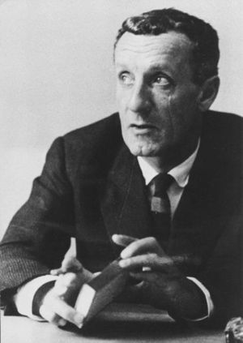
3. How can these problems be overcome?
  Merleau-Ponty, language, thought:
  Heidegger’s account focuses, however, on vocal expressions
  In Phenomenology of Perception (2014), MP gives a subtly different (although not incompatible) account of language with the body at its heart:
  “Our body, insofar as it moves itself, that is, insofar as it is inseparable from a perspective and is this very perspective brought into existence, is the condition of possibility[…] of all the expressive operations and of all the acquisitions that constitute the cultural world”
  Take away: the body is the foundation for (linguistic) expression to be possible

Slide 16

Merleau-Ponty, language, thought
  Spoken language is on a par with other forms of expression (Kee 2018), like pointing, for instance, which ‘indicates’ or shows “specific sensible points in the world” (Merleau-Ponty 1945/2014)
    E.g. pointing out a steeple to a friend vs. referring to the steeple in words
  What allows us to particular meanings, however, is down to the embeddedness of language in culture, the context in which we speak and how we speak

Slide 17

Merleau-Ponty, language, thought
  Kee (2020): our words imply a horizon of connected ideas, things and spaces that are associated with that word or phrase (like a web)
  This web is also shaped by our use of new and old meanings and the context in which they are used
    New meanings create new associations (“eleventy first”)
    Old meanings reinforce associations (“Bob’s your uncle”)
    Old meanings used in a novel way may build new bridges to other, established or new meanings (“like chalk and cheese”, “nan”, “pun”)
  If we can’t help but use language, we will be inherently relying on these old and new meanings to communicate all the time

Slide 18
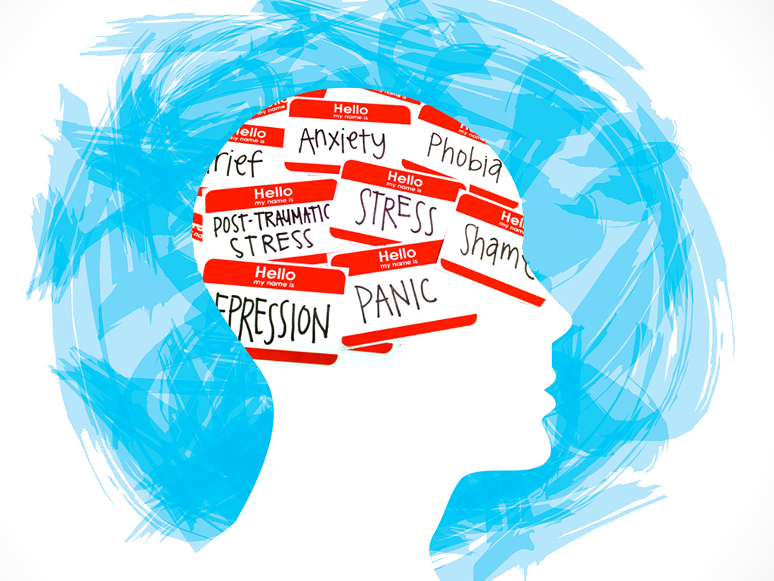
Merleau-Ponty, language, thought
  Consequences:
  The experience of the individual with mental disorder is shaped, in part, by the linguistic community itself in which the person is embedded
    What ‘happiness’ means, for instance, will importantly have an inherited ‘spoken speech’ aspect, touching on a horizon of connected concepts, which will draw out very specific aspects of the world for the individual looking for happiness
    Meaning is also shaped by their position as speaker or listener
  It is through the process of tapping into the shared web of connected meanings that the understanding of disordered experience, and how it is felt (e.g. as distressing, disorientating, or alienating) becomes possible

Slide 19
3. How can these problems be overcome?
  We can gain insight into disorder experience by understanding how language works by speakers and listeners
      Language doesn’t confer truth to a situation but specifies the meaningful relationships between speaker and listeners
      we may then ask why something matters to the person in question, what it means for them, and what implications it has for their life, even if the experience itself is difficult to communicate
  Importantly, we are limited by our cultural embeddedness and what parts of our linguistic practices we have in common, as well as what tools the disordered individual has to explain her experiences
  Even in trying to describe an ineffable or un-understandable experience, I suggest that we are still communicating something
    We are pointing out a relationship between ourselves and the world which just is ambiguous, undefined, unclear, disorientating, or alien

Slide 20

Thank you!

