Slide 1





Feminist Philosophy of Mind for Cognitive Science
Dr Jodie Louise Russell
Research Fellow (EPIC)
j.l.russell@bham.ac.uk ● @jelliedsours

Slide 2



Core Argument
Cognitive Science (despite incorporating humanities disciplines) acts like an apolitical empirical science
If feminist philosophy of science (FPS) is right to critique science for overlooking its non-epistemic commitments, then Cognitive Science falls prey to the same criticisms
Taking a FPM approach may help highlight and steer the non-epistemic commitments of CogSci within the specific project of understanding the mind

Slide 3

Virtuous Science: CogSci and Kuhn
My claim: Cognitive Science presents itself as an empirical and apolitical science
How should we understand this claim?
CogSci claims to partake in the norms or emulate the virtues of empirical and apolitical science at large
  Weaker: cognitive scientists imply that their work is empirical and apolitical

Slide 4

Virtuous Science: CogSci and Kuhn
Kuhn (1978), in the chapter “Objectivity, value judgement, and theory choice”, outlines 5 virtues of theory choice in science:
Accuracy
Consistency
Scope
Simplicity
Fruitfulness
According to Longino (1990) and Rooney (1992), these virtues were understood to be epistemic in nature; they seem to guide us towards knowledge/truth. They were not intended to be political in nature (thus science is apolitical)

Slide 5

Virtuous Science: CogSci and Kuhn
Q: does CogSci aim to follow these norms of theory choice, and thus act like any other science?
Plausibly yes: Meyer & Brancazio (2023), for example, understand the poor uptake of the enactive framework in CogSci due to its lack of fruitfulness:
  “For those scientists whose work is fine-grained and specialised towards precise explanatory tasks, many unprocessed enactive beliefs are too coarse to do anything with.”
Inference from this paper: if enactivism is to be ‘scientific’ it must be so in this distinctly epistemic way
I think this tells us something about our preconceptions of the ‘science’ done in Cognitive Science

Slide 6

The feminist critique of science
However, science is also shaped by non-epistemic virtues (i.e. social, political, ethical, economic goals etc.; Rooney 1992)*
  Newman et al. (1998) on comorbidity in medicine
  Reydon and Ereshefsky (2022) on scientific classification
The stance of being ‘apolitical’ is, itself, a political one (Longino 1996)
Some feminists argue that science should be guided by non-epistemic virtues (i.e., human flourishing; Kourany 2003)
*The difference between epistemic and non-epistemic virtues is contentious and not necessarily accepted (see Longino 1996, Rooney 1992)
Notes:
Lots of examples of biased science that is harmful and bad (e.g. race science) but I think these are two ‘good’ cases
Newman et al. (1998) note a division of different theoretical approaches to co-morbid disorder research between “splitters”, and “lumpers”
Newman et al. suggest that researchers should consider how sample populations are recruited, i.e. if, and how many, comorbid individuals are represented and from where they are recruited, as this will affect the data collected, and, consequently, how patients are treated
Suggestion: the focus on effective patient treatment is also non-epistemic in its aim.
The influence of social values isn’t what makes science ‘bad’ here; it is merely a feature of how science is conducted

Slide 7

CogSci as a political science
Does CogSci involve non-epistemic virtues? Plausibly, yes!
In The Imitation Game, when first introduced, a man had to try to convince an interrogator that he was a woman
In the second version, the man is simply replaced by a computer
Kind (2022): the test suggests that “[i]f a computer is as good at this kind of sophisticated imitation task as a man is, then we can infer intelligence on the part of the computer.”
How we test for (and identify) intelligence in artificial agents may then only reflect men’s behaviour

Slide 8
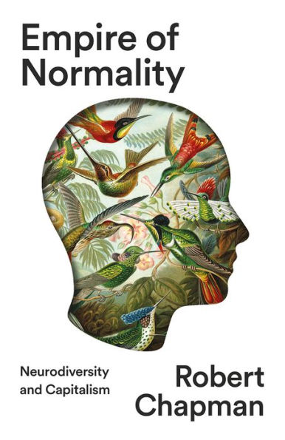
CogSci as a political science
Another example: Chapman (2023) argues that what we consider a ‘normal’ mind, or neurotypical, is itself a construction of capitalist processes
  Certain minds and bodies are suited to particular (profitable) kinds of work, and these are the ones that have been standardized and normalized
This has led to the marginalisation of disabled and neurodiverse people
In so far as CogSci is in the business of ‘standardizing’ mindedness, it is possible there may be construction of a standard along non-epistemic lines.

Slide 9

Why should we care to be feminists?
Worry: the issue is not the inclusion of non-epistemic virtues but the illusion that we can do CogSci without them
Failure to recognise the involvement of social and political goals can result in harm (especially when individuals are excluded from participating in these goals)
Fine, but why not just do feminist CogSci alongside mainstream CogSci?
Pluralism of CogSci goals would hamper feminist goals (which defeats the point of doing it in the first place)*
  Pluralism doesn’t guarantee uptake of feminist goals
  Pluralism doesn’t guarantee critical engagement with feminist goals (see Alexandrova 2018)
*Ask me more about my issues with pluralism in the Q&A!
Notes:
The ‘for’ here is intended prescriptively!

Slide 10

Feminism for Cognitive Science
FPM has similar goals to FPS (social justice and human flourishing) but it is distinct from FPS in that it is interested specifically in how we study the mind
  FPS is possibly the umbrella term here
  In this way, there is more of a focus on the object of study (mindedness) than the individuals carrying out the research (scientists) but both will be important for FPM!
This inherently incorporates researchers beyond the sciences, incl. philosophy itself, and may even blur the lines of what we want to call science (a queer science?*)
It champions mixed methods (methodological promiscuity) and inclusivity
Asks questions such as:
How do features such as gender and race affect our experience of the world, as minded beings?
Who, or what, gets to be said to have a mind? What’s involved in that criteria?
What are our assumptions behind what a mind is? Who gets to investigate it?
*this is another project for another time

Slide 11

The virtues of a feminist approach
CogSci is a fragmentary discipline with many different methods and goals (Núñez et al. 2019), but united by some attempt to understand mindedness (be it organic or artificial)
FPM could act as an overarching framework to critique CogSci broadly in reference to goals of social justice
This may add some consistency and cohesion among projects in developing science that’s good for humanity
Its emphasis on mixed methods may facilitate epistemic goals (e.g. coherence) as well by encouraging integration of disciplines
Without feminist input, certain projects way unwittingly do harm in the long term and valuable knowledge will certainly be excluded

Slide 12
Thank you!
Please feel free to drop me a line:
j.l.russell@bham.ac.uk ● @jelliedsours

